Slide 1

Athletix - A Fitness Intelligence Technology
Group Members
Subhan Tariq (22P-9067)
Azhan Shoaib (22P-9054)
Khawaja Abdullah Ishaq (22P-9375)
Project Supervisor
Dr. Muhammad Amin

Slide 2
Introduction
Rising global interest in health & fitness, but access to personal trainers is limited by cost, availability, and inclusivity.
Existing fitness apps mostly provide generic workout & diet templates, ignoring body type, cultural diets, or personal needs.
Even human trainers often give advice based on what worked for them, not what is optimal for the client.
Our project introduces Fitness Intelligence Technology:
A Virtual AI Fitness Trainer that provides personalized workouts, real-time form analysis, and culturally/medically adaptable diet plans.
Bridges the gap between human coaching and digital health technology, making fitness accessible, adaptive, and safe.

Slide 3
Problem Statement
Current fitness apps lack true personalization, adaptability, and real-time form feedback, while human trainers are costly–creating a gap for an accessible, all-in-one intelligent fitness solution.

Slide 4
Solution
Fitness Intelligence Technology - A Virtual AI Trainer that:
Answers fitness & nutrition queries.
Provides personalized workouts & diet plans.
Performs real-time form analysis.
Learns and adapts continuously.
Delivered as a cross-platform mobile app (React Native) with FastAPI backend.

Slide 5
Literature Review
Existing Gap (Problem in Current Solutions) | Athletix - Fitness Intelligence Technology (Our Solution) | References
Lack of validated, long-term outcomes and standardized evaluation for fitness improvement. | Builds an evidence-first pipeline with real-user validation, adherence tracking, and standardized efficacy testing. | [1] Tumulty et al.; [2] Negreiros et al.
Manual data entry for reps and form, leading to low accuracy and reduced engagement. | Integrates HRNet-based computer vision for automatic rep counting and real-time form analysis. | [3] Guo et al.; [4] Appiah et al.; [5] Riccio
Lack of adaptive personalization and psychological/contextual reinforcement. | Implements contextual bandits, goal-setting, and social comparison models to personalize fitness feedback and maintain motivation. | [6] Zhao et al.; [7] Tong et al.; [10] Swaminathan et al.
Local dietary inaccuracies due to cultural and portion-size variations. | Uses constraint-based diet planning with culturally and regionally adapted food datasets. | [8] Müller et al.; [14] USDA; [15] WHO
Generic LLM-based guidance often produces unsafe or inaccurate health suggestions. | Fine-tunes a Domain-Specific RAG Model trained on verified sources and clinician-approved corpora for safe and accurate recommendations. | [9] Lewis et al.; [13] Lewis et al.
Few mobile fitness solutions achieve both low-latency and high-accuracy pose detection under real-world conditions. | Deploys lightweight CV inference optimized for mobile devices with dynamic error correction and latency control. | [4] Appiah et al.; [5] Gym Tracker System
Limited behavioral motivation and adherence mechanisms in current fitness apps. | Introduces gamified adherence monitoring and progress visualization using real-time performance analytics. | [7] Tong et al.; [10] Swaminathan et al.; [16] Azam
Lack of integrated dietary and exercise recommendation linking nutrition with physical activity metrics. | Integrates multi-modal data fusion between exercise metrics and nutrition intake for holistic fitness planning. | [11] Ahmad et al.
Existing systems fail to connect real-world experts for contextual validation. | Incorporates expert feedback and local trainer data to validate recommendations for personalized fitness plans. | [16] Azam

Slide 6
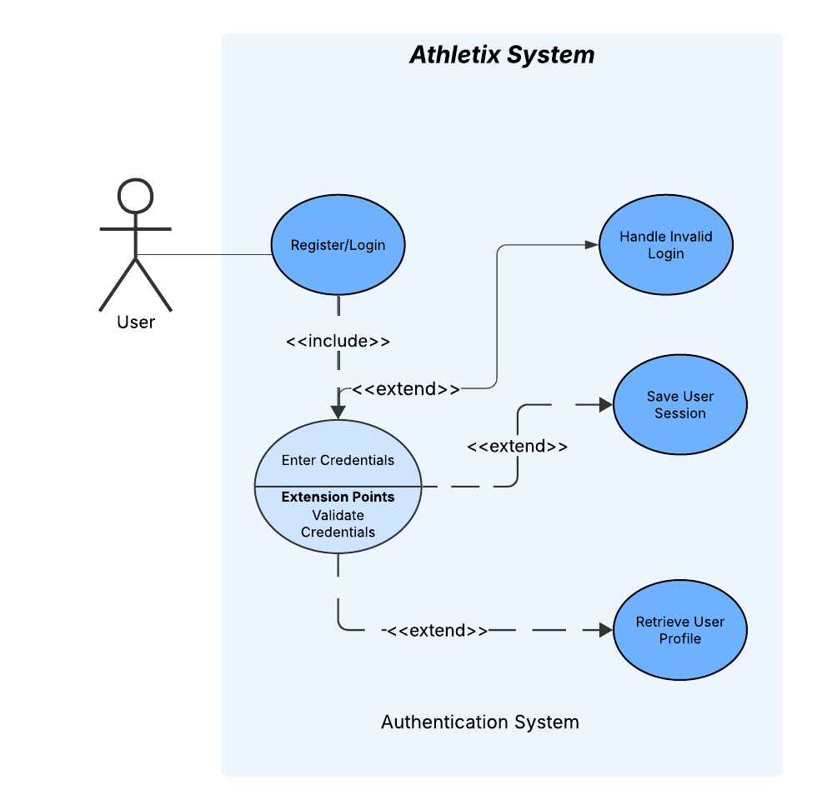
Use Case Diagram

Slide 7
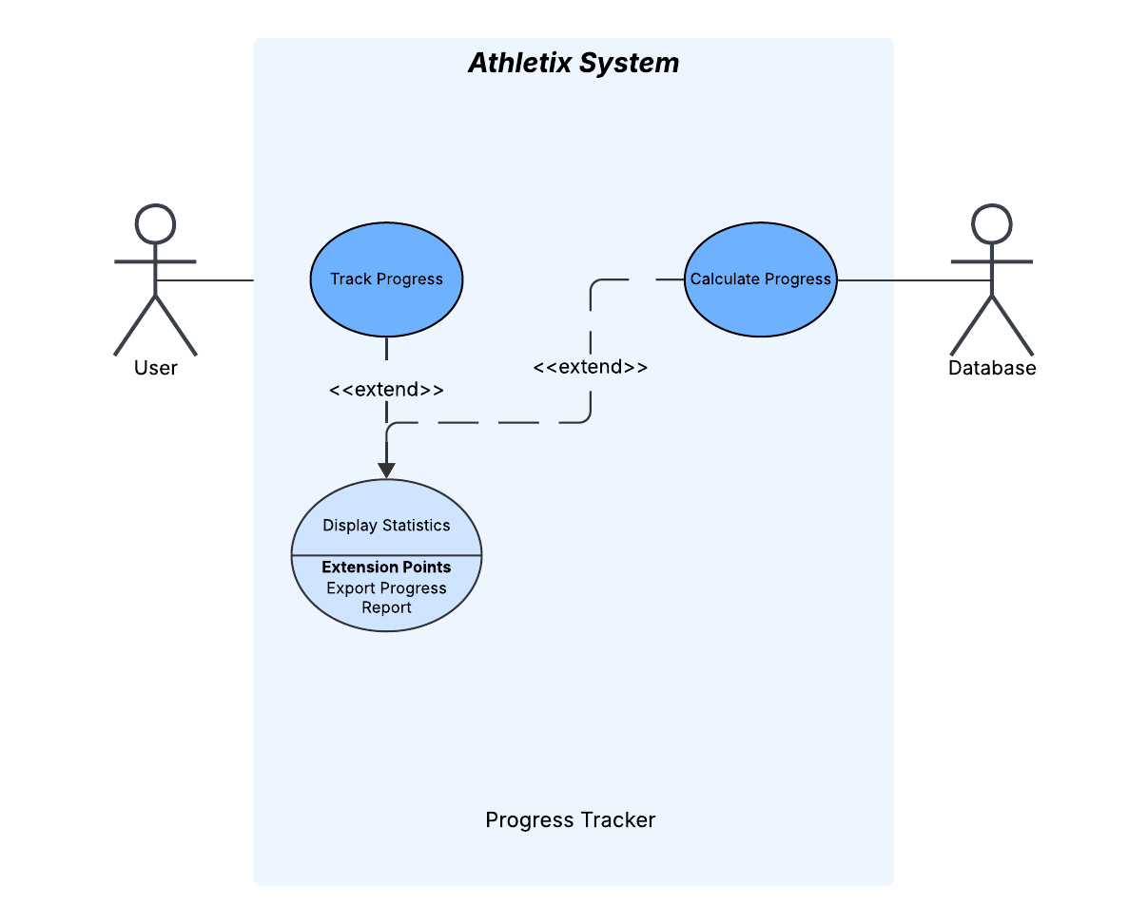
Use Case Diagram

Slide 8
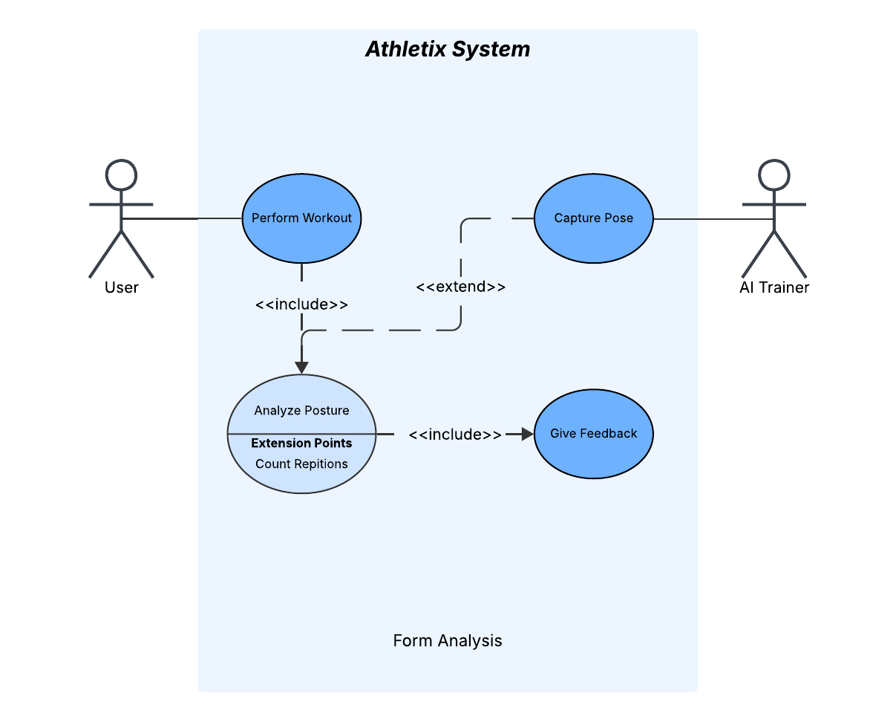
Use Case Diagram

Slide 9
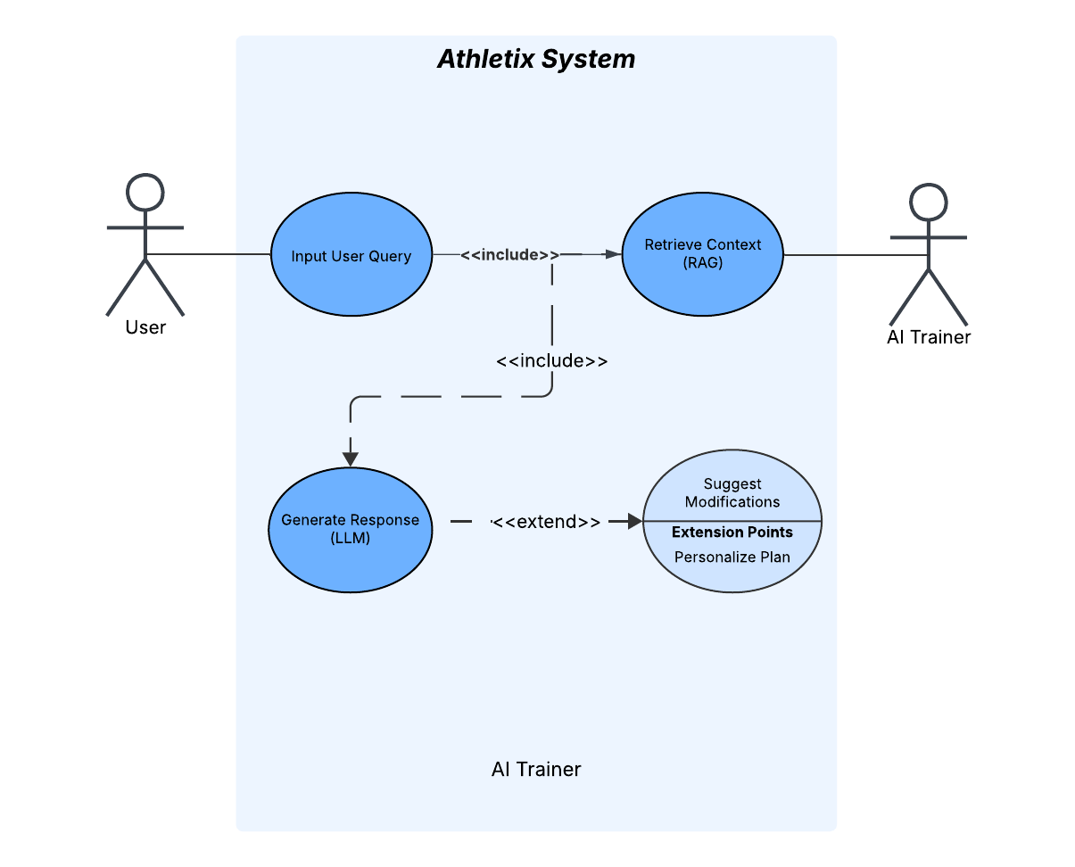
Use Case Diagram

Slide 10
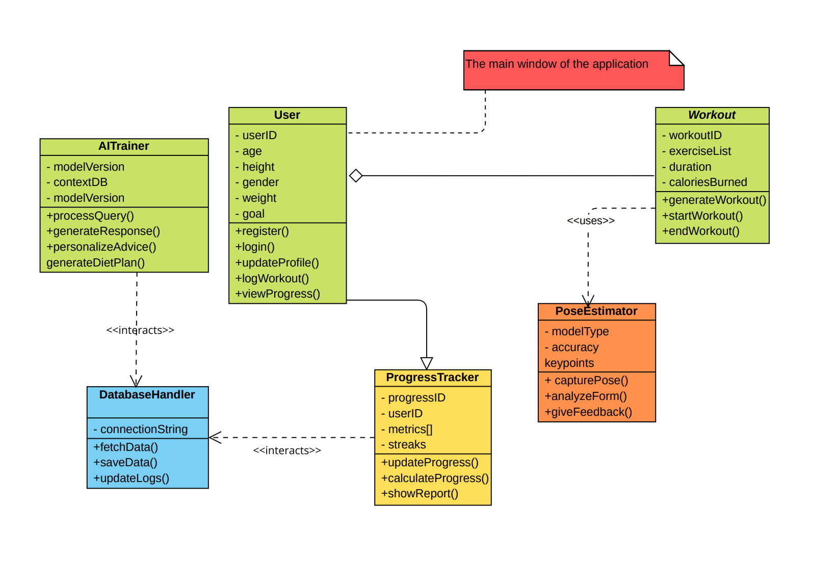
Class Diagram

Slide 11
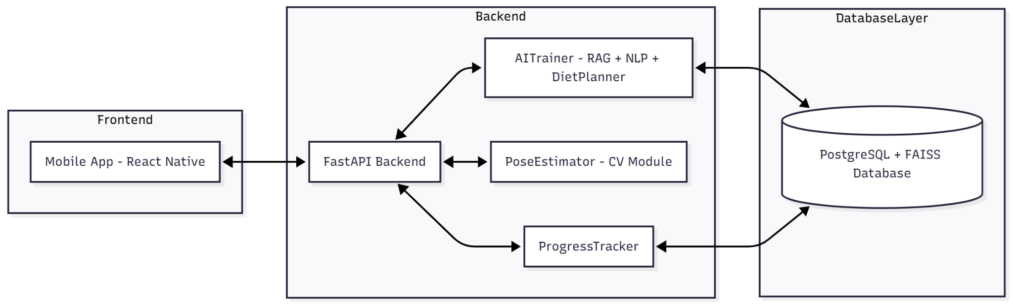
Component Diagram

Slide 12
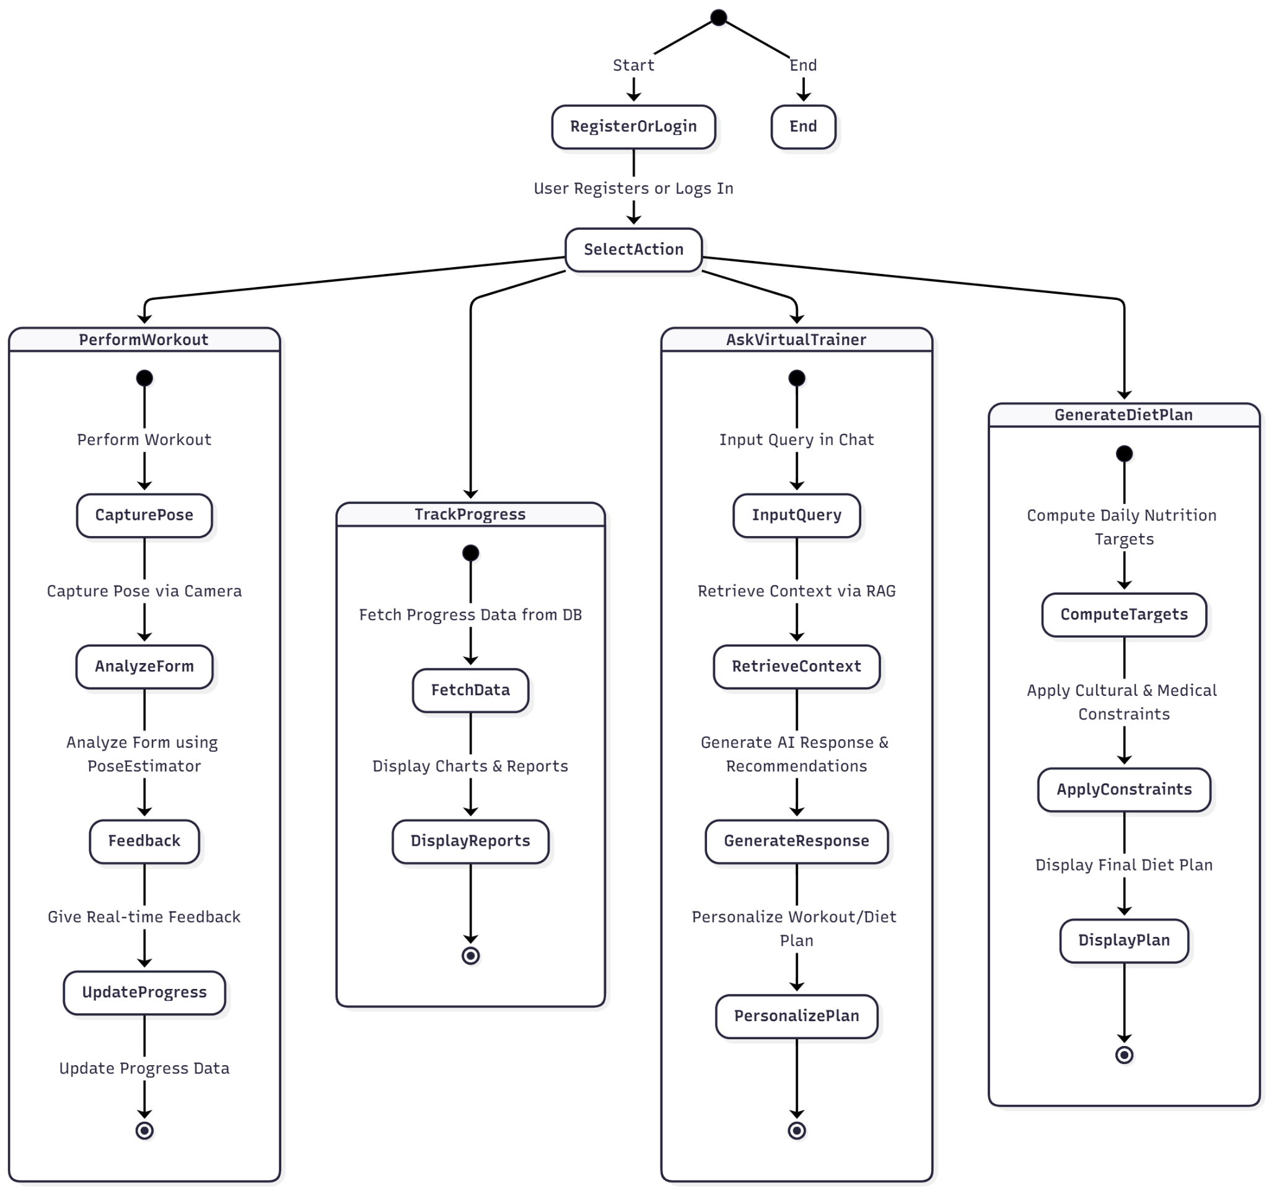
Activity Diagram

Slide 13
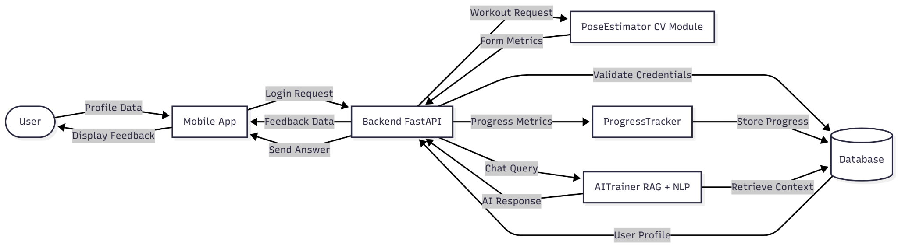
Flow Diagram

Slide 14
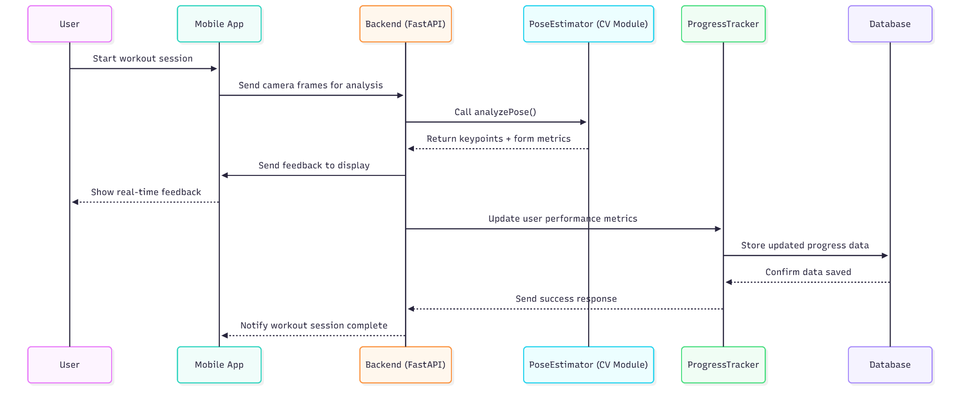
Sequence Diagram

Slide 15
UI/UX Design

Slide 16

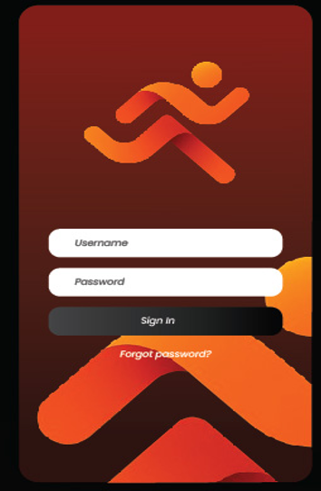
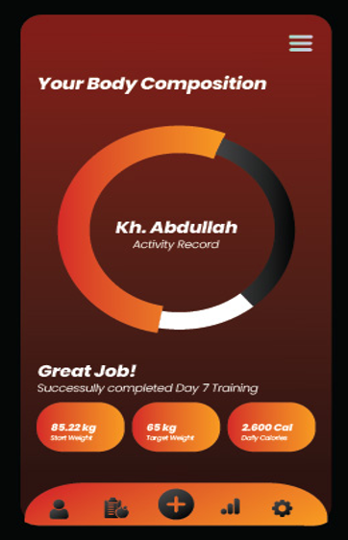
1
FRONT SCREEN
2
LOGIN/OUT
3
DASHBORAD 1

Slide 17
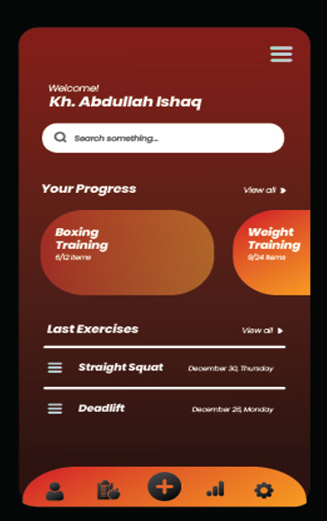
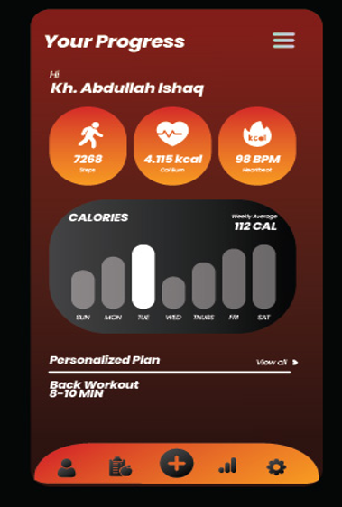

4
DASHBOARD 2
5
CALORIES COUNT
6
POSTURE

Slide 18
Datasets
USDA FoodData Central
https://fdc.nal.usda.gov/food-search?type=Branded
https://fdc.nal.usda.gov/food-search?type=Foundation
Foundation Foods Scientifically analyzed natural foods like grains or legumes with detailed nutrient data (protein, vitamins, minerals). Example: Boiled Chickpeas (Chana) — shows accurate protein, fiber, and iron per 100g, useful for traditional Pakistani meals.
Branded Foods Commercially packaged items with manufacturer-provided nutrition info (calories, fat, carbs, sugars). Example: Granola, Cinnamon Raisin — 500 kcal, 57g carbs, 10.7g protein, 25g fat per serving; useful for processed food analysis.

Slide 19
Datasets
Gym Related Datasets
https://www.kaggle.com/datasets/niharika41298/gym-exercise-data
https://www.kaggle.com/datasets/aadarshvelu/gym-equipements-classification
https://www.kaggle.com/datasets/ahrnishpdahal/gymshark-products-dataset
These datasets provide detailed information on gym exercises, equipment images, and fitness products. They’ll be used to train the virtual AI trainer for exercise recognition, equipment classification, and personalized workout planning. Together, they enable accurate responses to all gym-related queries within the Athletix system.

Slide 20
Datasets
Form Analysis Dataset
Custom video dataset: We collect exercise videos from multiple subjects (diverse body shapes/sizes) performing movements with both correct and incorrect form.
Pose keypoint extraction: Use vision models (e.g. Google MediaPipe, MoveNet) to detect body landmarks in each frame (MediaPipe yields ~33 joint points; MoveNet yields 17 keypoints from head to ankle).
Form labeling: Each rep is annotated “correct” or “incorrect” based on biomechanical criteria and expert rules (e.g. joint-angle thresholds derived from anatomy/physiotherapy).
Public data for augmentation: Standard pose datasets may supplement training. For example, COCO-Pose offers ~200K images with 17-keypoint annotations, and MPII provides ~25K images (~40K annotated poses) for pre-training pose models.

Slide 21
Expected Result
Personalized Fitness Companion: Onboarding with user profile generates tailored workout & diet plans.
Smart Guidance: Real-time camera-based form analysis + conversational Virtual Trainer for Q&A, modifications, and safe alternatives.
Progress Tracking: Dashboard showing adherence, deviations, and improvements.
Evaluation: Reports on form-analysis accuracy, trainer Q&A accuracy, and pilot user adherence.

Slide 22
Scope of the project
In-Scope:
Personalized workout & diet plans
Real-time Form analysis
Virtual fitness trainer (Q&A, tips)
Progress tracking & adaptive improvement
Mobile app access
Out-of-Scope:
No wearable device support
No medical diagnosis
No heavy on-device processing
No social/community features

Slide 23
Goals
Build a Virtual AI Trainer that personalizes workouts and diet plans for each user.
Provide real-time guidance to improve exercise form and prevent injuries.
Adapt recommendations based on user progress and feedback.
Act as a fitness companion to answer health, workout, and nutrition questions.
Track user progress in workouts, calories, and nutrition.
Deliver a simple, accessible mobile app for everyone.

Slide 24
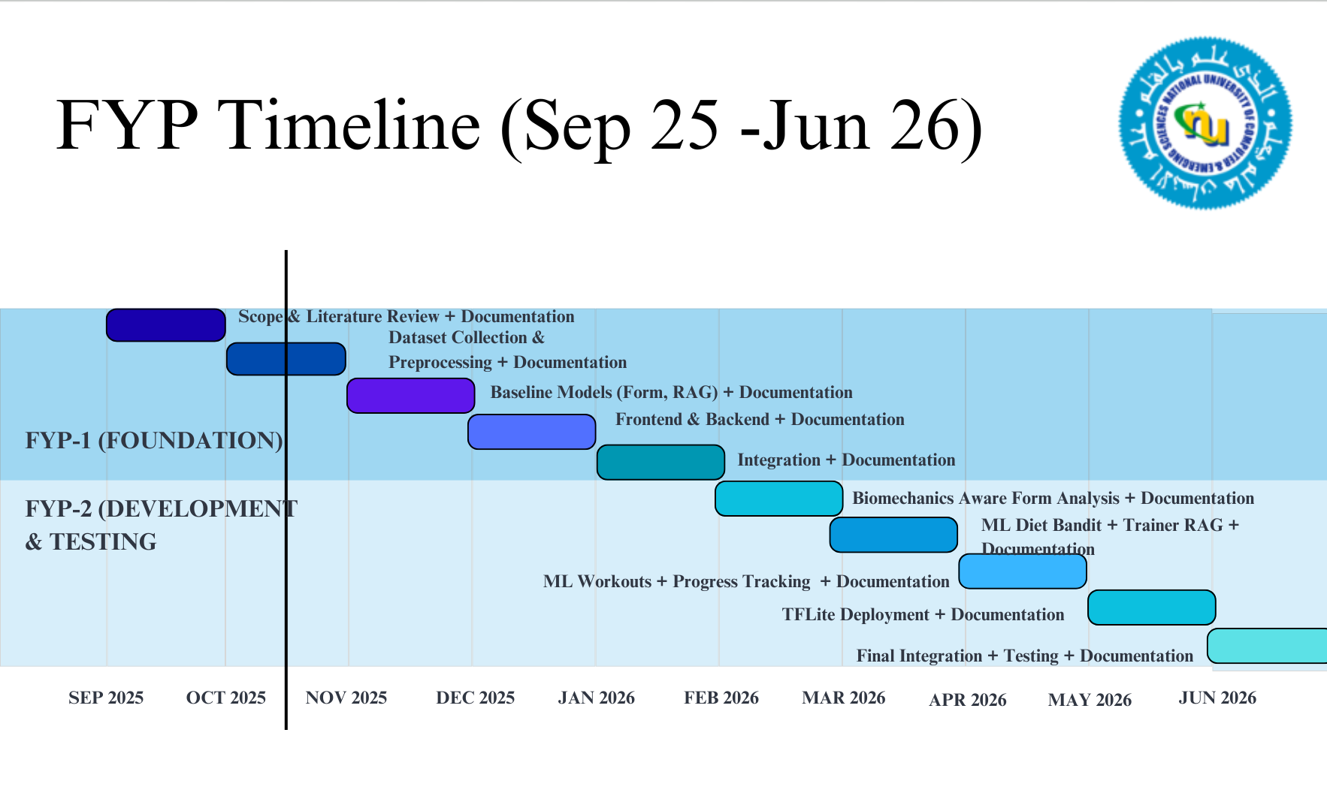
Objectives
Objectives of the project FYP 1 and 2 preferred in Gant Chart based timeline

Slide 25
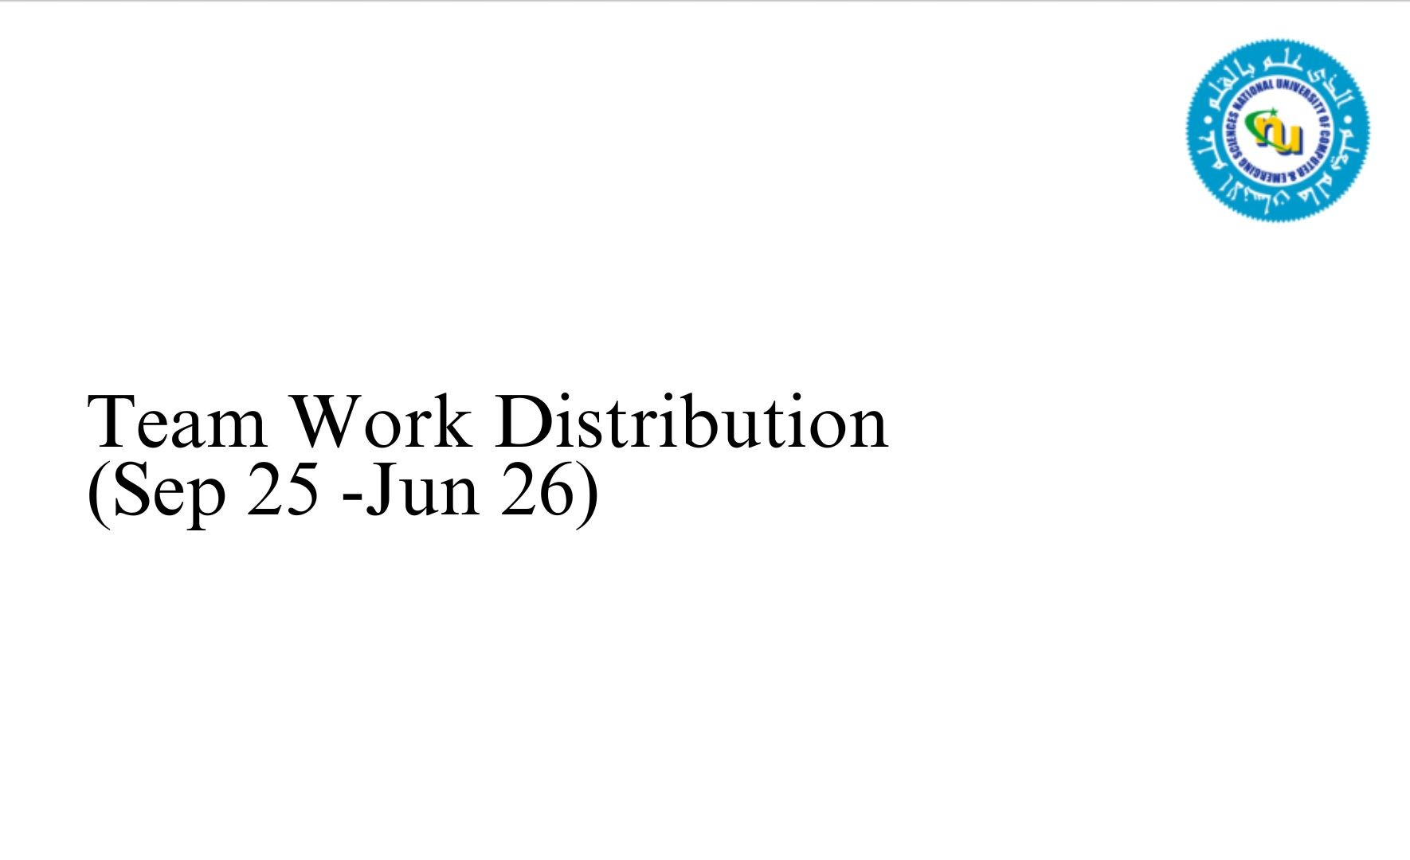
Team Work
You will be evaluated on the below component on two marks
This can also be shown in the timeline
How effective was the work distribution. Ideally there should be equal contribution from all group members in each of the major phase e.g. Requirements, design etc.

Slide 26
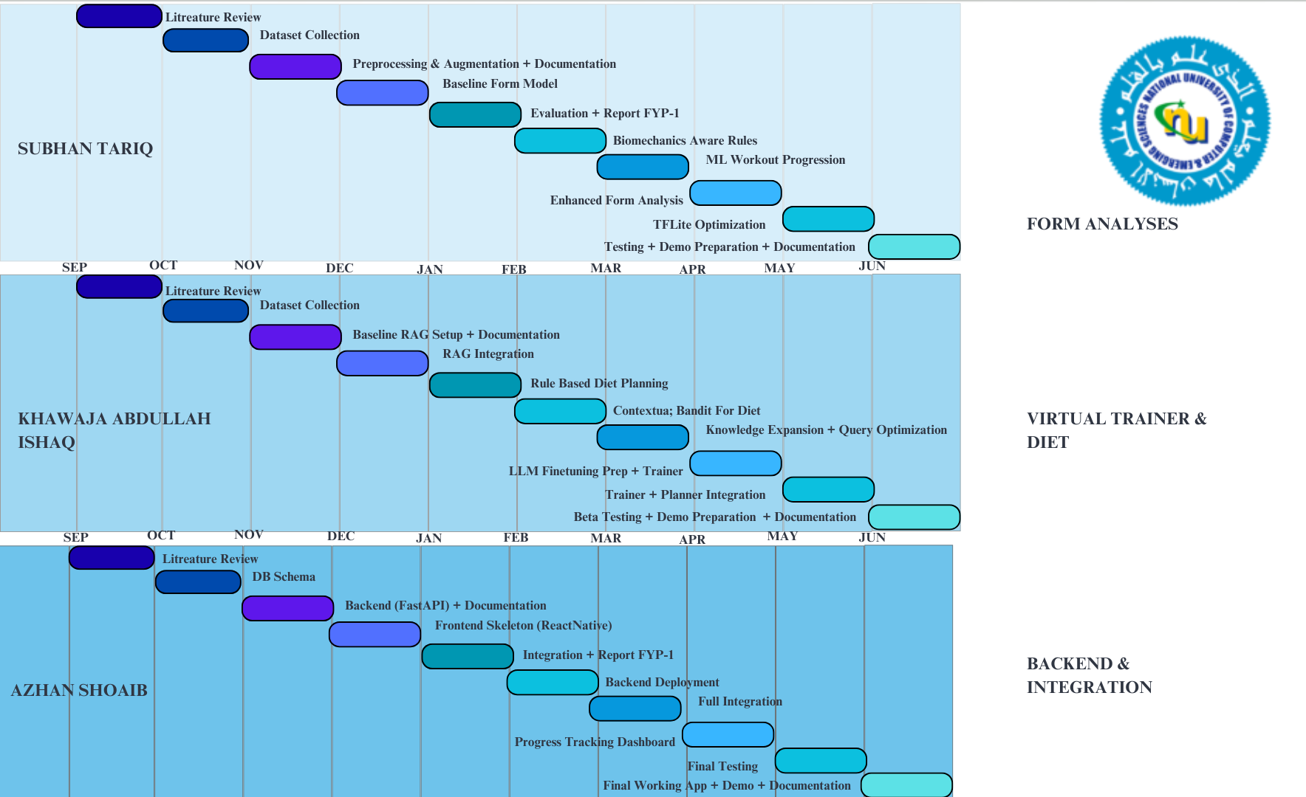
Team Work
You will be evaluated on the below component on two marks
This can also be shown in the timeline
How effective was the work distribution. Ideally there should be equal contribution from all group members in each of the major phase e.g. Requirements, design etc.

Slide 27
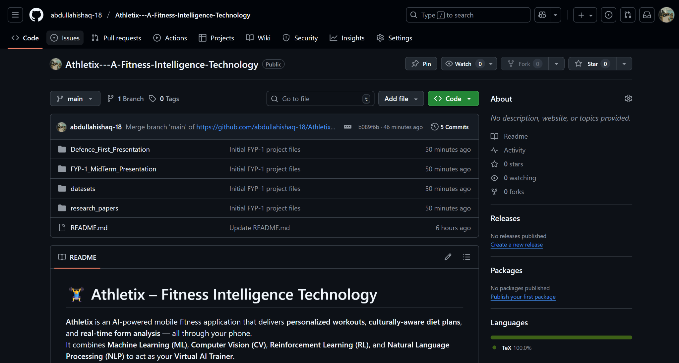
Links
github repo

Slide 28
References
[1] E. Tumulty et al., “The effect of a physical activity intervention on long-term fitness outcomes: A systematic review and meta-analysis,” J. Phys. Act. Health, vol. 16, no. 12, pp. 1047–1058, Dec. 2019. [2] F. Negreiros et al., “Standardization of physical fitness assessment: A review of current practices and future directions,” Sports Med. Open, vol. 8, no. 1, p. 132, Dec. 2022. [3] H. Guo et al., “Improving data accuracy in fitness tracking: The role of automated data capture,” in Proc. Int. Conf. Health Inf. Syst. Technol., 2024, pp. 120–125. [4] P. A. Appiah et al., “Real-time human pose estimation for accurate repetition counting and form analysis in mobile fitness applications,” IEEE Access, vol. 12, pp. 45678–45690, 2024. [5] Gym Tracker System, “Reducing manual data entry errors in gym management systems,” Tech. Rep. 2025-01, 2025.
[6] R. Zhao et al., “Context-aware personalized recommendation in health and fitness,” ACM Trans. Intell. Syst. Technol., vol. 11, no. 6, pp. 1–25, Nov. 2020. [7] H. L. Tong et al., “The impact of goal-setting and social comparison on long-term adherence to physical activity programs,” Psychol. Sport Exerc., vol. 64, p. 102319, Jul. 2022. [8] M. Müller et al., “Accuracy in dietary assessment: Addressing local variations and portion size estimation errors,” Nutrients, vol. 13, no. 7, p. 2389, Jul. 2021.

Slide 29
References
[9] C. Lewis et al., “Safety and reliability of large language models for health and medical guidance,” JAMA Intern. Med., vol. 180, no. 10, pp. 1361–1363, Oct. 2020. [10] V. Swaminathan and S. K. Pattanayak, “A critical analysis on the factors impacting the consumers adoption of fitness applications on smartphones,” Int. J. Fin. Mark. Res. (IJFMR), vol. 5, no. 1, Jan.–Feb. 2023. [Online]. Available: https://doi.org/10.36948/ijfmr.2023.v05i01.1316 IJFMR+1 [11] R. Riccio, “Real-time fitness exercise classification and counting from video frames,” Dept. of Mathematics, Univ. of Pavia, Italy, Nov. 2024. [Online]. Available: https://arxiv.org/abs/2411.11548 arXiv+1 [12] M. Ahmad, M. A. Khan, M. Bibi, Z. Ullah, and S. T. Shah, “Mobile apps for human nutrition: A review,” Univ. of Agriculture, Peshawar & Bolan Univ. of Med. & Health Sci., 2021. [13] P. Lewis, E. Perez, A. Piktus, F. Petroni, V. Karpukhin, N. Goyal, … D. Kiela, “Retrieval-augmented generation for knowledge-intensive NLP tasks,” Facebook AI Research & Univ. College London, 2020. [14] U.S. Dept. of Agriculture, USDA FoodData Central, 2023. [Online]. Available: https://fdc.nal.usda.gov/ [15] World Health Organization, Physical Activity Guidelines, 2024. [Online]. Available: https://www.who.int/ [16] Z. Azam, personal communication, Fitness Trainer & Nutritionist, Skinholics/Bodyholics, Rahim Yar Khan, Pakistan, 2025.

